Slide 1
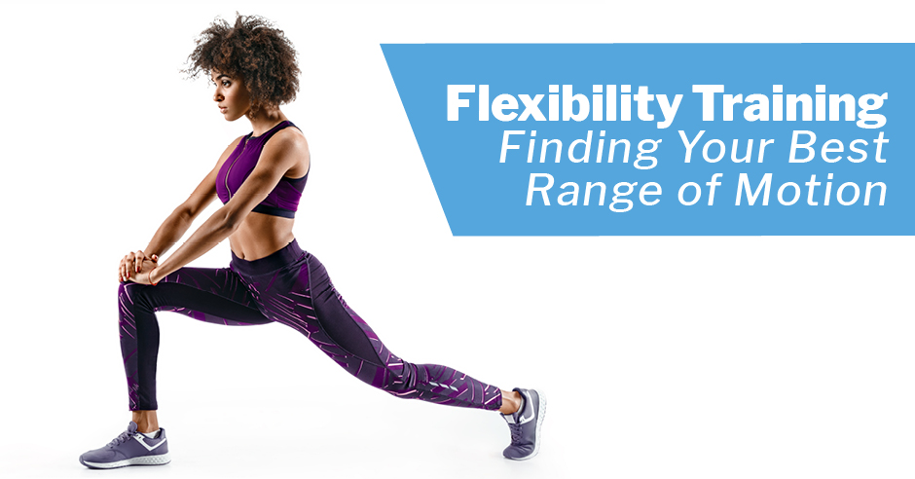
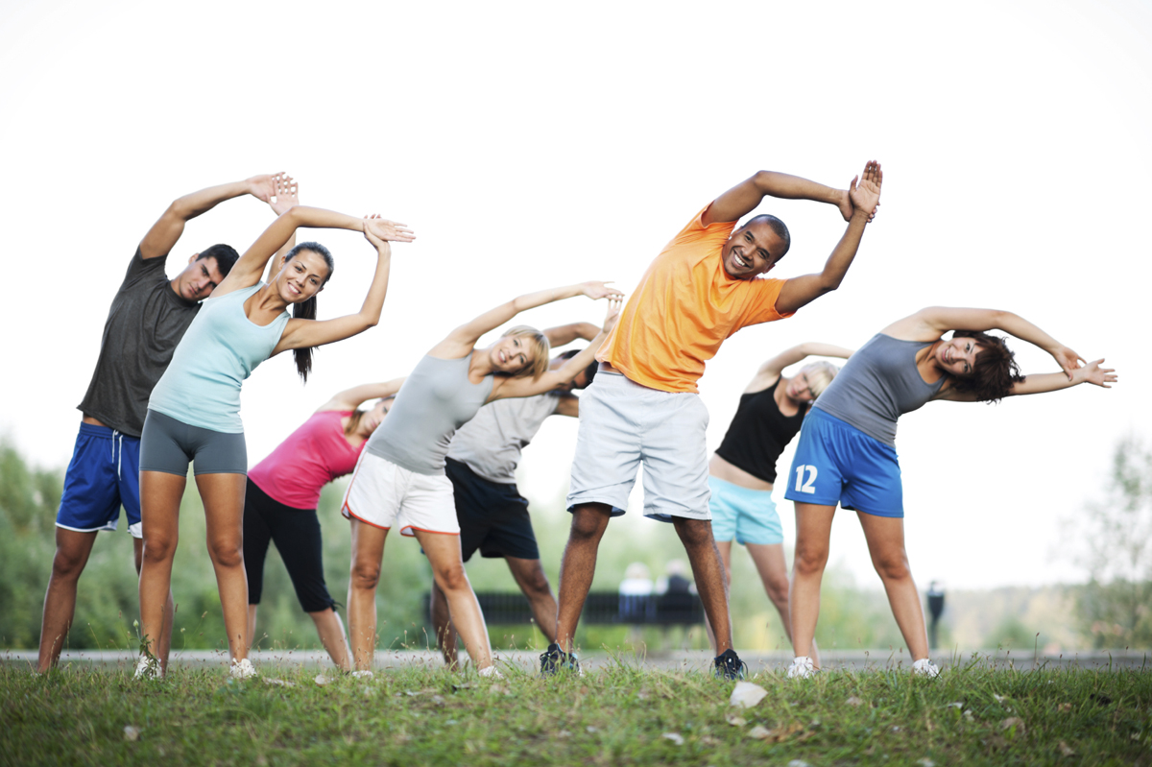
Understanding Mobility and Stability
Mobility
The ability of a joint to move through its full range of motion.
Examples of Mobile Joints:
Ankle: Moves in the sagittal plane.
Hip: Moves in multiple planes (flexion, extension, rotation).
Stability
The ability of muscles and connective tissues to control joint movement.
Example: Core stability during a plank exercise.
Chapter 3: Mobility Training and Assessment of Movement Competency
WEEK 8
Introduction to Movement Competency
Movement competency refers to the ability to perform fundamental movements with proper technique.
Importance
Critical for fitness activities, reducing injury risks, and enhancing performance.

Slide 2
Understanding Mobility and Stability
Mobility
The ability of a joint to move through its full range of motion.
Examples of Mobile Joints:
Ankle: Moves in the sagittal plane.
Hip: Moves in multiple planes (flexion, extension, rotation).
Stability
The ability of muscles and connective tissues to control joint movement.
Example: Core stability during a plank exercise.
Chapter 3: Mobility Training and Assessment of Movement Competency
WEEK 8
Introduction to Movement Competency
Movement competency refers to the ability to perform fundamental movements with proper technique.
Importance
Critical for fitness activities, reducing injury risks, and enhancing performance.

Slide 3
Mobility Training
Enhances freedom of movement in joints.
Reduces risk of injuries related to joint dysfunction.
Key Exercises
    Dynamic stretching (e.g., leg swings)
    Joint mobilization exercises (e.g., hip circles)
Warm-Up: Preparing the Body for Activity
Preparatory exercises performed before engaging in more vigorous activities.
Activates the nervous, circulatory, and respiratory systems.
Types of Warm-Ups
  General Warm-Up: Low-intensity exercises like brisk walking or light jogging.
  Specific Warm-Up: Exercises that mimic the movements of the activity to be performed.
Understanding Mobility and Stability
Mobility
The ability of a joint to move through its full range of motion.
Examples of Mobile Joints:
Ankle: Moves in the sagittal plane.
Hip: Moves in multiple planes (flexion, extension, rotation).
Stability
The ability of muscles and connective tissues to control joint movement.
Example: Core stability during a plank exercise.
Chapter 3: Mobility Training and Assessment of Movement Competency
WEEK 8
Introduction to Movement Competency
Movement competency refers to the ability to perform fundamental movements with proper technique.
Importance
Critical for fitness activities, reducing injury risks, and enhancing performance.

Slide 4

Mobility Training
Enhances freedom of movement in joints.
Reduces risk of injuries related to joint dysfunction.
Key Exercises
    Dynamic stretching (e.g., leg swings)
    Joint mobilization exercises (e.g., hip circles)
Warm-Up: Preparing the Body for Activity
Preparatory exercises performed before engaging in more vigorous activities.
Activates the nervous, circulatory, and respiratory systems.
Types of Warm-Ups
  General Warm-Up: Low-intensity exercises like brisk walking or light jogging.
  Specific Warm-Up: Exercises that mimic the movements of the activity to be performed.
Dynamic Warm-Up Techniques
Purpose
Actively warms up the body through movement.
Improves joint mobility and muscle temperature.
  Examples:
  Arm Circles: Increases shoulder mobility.
  High Knees: Activates the hip flexors and increases heart rate.
Understanding Mobility and Stability
Mobility
The ability of a joint to move through its full range of motion.
Examples of Mobile Joints:
Ankle: Moves in the sagittal plane.
Hip: Moves in multiple planes (flexion, extension, rotation).
Stability
The ability of muscles and connective tissues to control joint movement.
Example: Core stability during a plank exercise.
Chapter 3: Mobility Training and Assessment of Movement Competency
WEEK 8
Introduction to Movement Competency
Movement competency refers to the ability to perform fundamental movements with proper technique.
Importance
Critical for fitness activities, reducing injury risks, and enhancing performance.

Slide 5
Mobility Training
Enhances freedom of movement in joints.
Reduces risk of injuries related to joint dysfunction.
Key Exercises
    Dynamic stretching (e.g., leg swings)
    Joint mobilization exercises (e.g., hip circles)
Warm-Up: Preparing the Body for Activity
Preparatory exercises performed before engaging in more vigorous activities.
Activates the nervous, circulatory, and respiratory systems.
Types of Warm-Ups
  General Warm-Up: Low-intensity exercises like brisk walking or light jogging.
  Specific Warm-Up: Exercises that mimic the movements of the activity to be performed.
Effects of a Good Warm-Up
Physical Benefits
1. Increased Heart Rate: Enhances blood circulation.
2. Higher Muscle Temperature: Leads to more forceful contractions and quicker relaxation.
3. Improved Joint Mobility:
Dynamic Warm-Up Techniques
Purpose
Actively warms up the body through movement.
Improves joint mobility and muscle temperature.
  Examples:
  Arm Circles: Increases shoulder mobility.
  High Knees: Activates the hip flexors and increases heart rate.
Understanding Mobility and Stability
Mobility
The ability of a joint to move through its full range of motion.
Examples of Mobile Joints:
Ankle: Moves in the sagittal plane.
Hip: Moves in multiple planes (flexion, extension, rotation).
Stability
The ability of muscles and connective tissues to control joint movement.
Example: Core stability during a plank exercise.
Chapter 3: Mobility Training and Assessment of Movement Competency
WEEK 8
Introduction to Movement Competency
Movement competency refers to the ability to perform fundamental movements with proper technique.
Importance
Critical for fitness activities, reducing injury risks, and enhancing performance.
Reduces the risk of injuries.
Mental Benefits
Increased Mental Readiness: Prepares the mind for the activity ahead.
Case Study: Effective Warm-Up in Sports
Study by Silva et al. (2018)
Findings: 10-minute active warm-up with gradual intensity increase.
Recommendation: Use heated garments to maintain muscle temperature post warm-up.
Example Application: Soccer players perform dynamic stretches followed by sprints to simulate game conditions.

Slide 6

Dynamic Warm-Up Techniques
Purpose
Actively warms up the body through movement.
Improves joint mobility and muscle temperature.
  Examples:
  Arm Circles: Increases shoulder mobility.
  High Knees: Activates the hip flexors and increases heart rate.
Effects of a Good Warm-Up
Physical Benefits
1. Increased Heart Rate: Enhances blood circulation.
2. Higher Muscle Temperature: Leads to more forceful contractions and quicker relaxation.
3. Improved Joint Mobility:
Cool-Down and Flexibility Training
Cool down is the gradual reduction of exercise intensity to return to resting state.
Cool-Down Techniques
Static Stretching: Holding a stretch for 20-30 seconds (e.g., hamstring stretch).
Flexibility Training: Improves joint range of motion through controlled stretching.
Reduces the risk of injuries.
Mental Benefits
Increased Mental Readiness: Prepares the mind for the activity ahead.
Case Study: Effective Warm-Up in Sports
Study by Silva et al. (2018)
Findings: 10-minute active warm-up with gradual intensity increase.
Recommendation: Use heated garments to maintain muscle temperature post warm-up.
Example Application: Soccer players perform dynamic stretches followed by sprints to simulate game conditions.

Slide 7
Dynamic Warm-Up Techniques
Purpose
Actively warms up the body through movement.
Improves joint mobility and muscle temperature.
  Examples:
  Arm Circles: Increases shoulder mobility.
  High Knees: Activates the hip flexors and increases heart rate.
Effects of a Good Warm-Up
- Physical Benefits
1. Increased Heart Rate: Enhances blood circulation.
2. Higher Muscle Temperature: Leads to more forceful contractions and quicker relaxation.
3. Improved Joint Mobility:
Types of Stretching Techniques
Static Stretching
Example: Reaching down to touch toes and holding.
Proprioceptive Neuromuscular Facilitation (PNF)
Combines static stretch and isometric stretching.
Example: Partner-assisted hamstring stretch with resistance.
Functional Core Assessment
Purpose
Identifies limitations in mobility and flexibility.
Application
Used in both warm-up routines and movement preparation.
Example: Plank assessment to evaluate core stability and hip mobility.
Cool-Down and Flexibility Training
Cool down is the gradual reduction of exercise intensity to return to resting state.
Cool-Down Techniques
Static Stretching: Holding a stretch for 20-30 seconds (e.g., hamstring stretch).
Flexibility Training: Improves joint range of motion through controlled stretching.
Reduces the risk of injuries.
Mental Benefits
Increased Mental Readiness: Prepares the mind for the activity ahead.
Case Study: Effective Warm-Up in Sports
Study by Silva et al. (2018)
Findings: 10-minute active warm-up with gradual intensity increase.
Recommendation: Use heated garments to maintain muscle temperature post warm-up.
Example Application: Soccer players perform dynamic stretches followed by sprints to simulate game conditions.

Slide 8
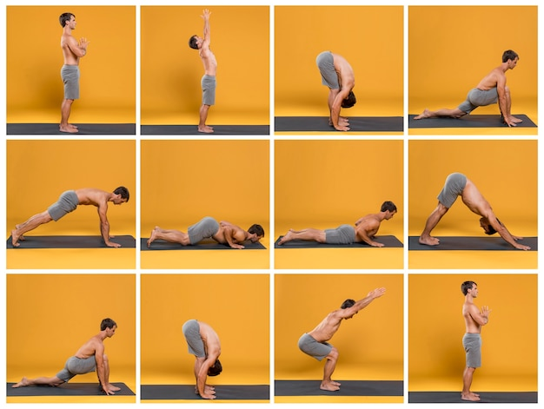
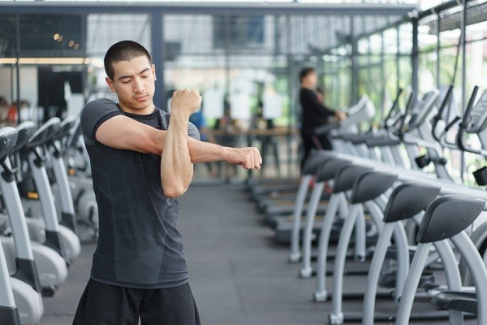
Mobility Training
- Enhances freedom of movement in joints.
- Reduces risk of injuries related to joint dysfunction.
Key Exercises
    Dynamic stretching (e.g., leg swings)
    Joint mobilization exercises (e.g., hip circles)
Warm-Up: Preparing the Body for Activity
Preparatory exercises performed before engaging in more vigorous activities.
Activates the nervous, circulatory, and respiratory systems.
Types of Warm-Ups
  General Warm-Up: Low-intensity exercises like brisk walking or light jogging.
  Specific Warm-Up: Exercises that mimic the movements of the activity to be performed.
Dynamic Warm-Up Techniques
Purpose
Actively warms up the body through movement.
Improves joint mobility and muscle temperature.
  Examples:
  Arm Circles: Increases shoulder mobility.
  High Knees: Activates the hip flexors and increases heart rate.
Effects of a Good Warm-Up
- Physical Benefits
1. Increased Heart Rate: Enhances blood circulation.
2. Higher Muscle Temperature: Leads to more forceful contractions and quicker relaxation.
3. Improved Joint Mobility:
Cool-Down and Flexibility Training
Cool down is the gradual reduction of exercise intensity to return to resting state.
Cool-Down Techniques
Static Stretching: Holding a stretch for 20-30 seconds (e.g., hamstring stretch).
Flexibility Training: Improves joint range of motion through controlled stretching.
Types of Stretching Techniques
Static Stretching
Example: Reaching down to touch toes and holding.
Proprioceptive Neuromuscular Facilitation (PNF)
Combines static stretch and isometric stretching.
Example: Partner-assisted hamstring stretch with resistance.
Functional Core Assessment
Purpose
Identifies limitations in mobility and flexibility.
Application
Used in both warm-up routines and movement preparation.
Example: Plank assessment to evaluate core stability and hip mobility.
Summary of Key Concepts
Mobility and Stability: Foundation of movement competency.
Warm-Up: Prepares the body and mind for physical activity.
Cool-Down and Flexibility: Essential for recovery and injury prevention.
Practical Application: Use a mix of dynamic and static exercises for comprehensive training.
Reduces the risk of injuries.
Mental Benefits
Increased Mental Readiness: Prepares the mind for the activity ahead.

Slide 9
Dynamic Warm-Up Techniques
Purpose
Actively warms up the body through movement.
Improves joint mobility and muscle temperature.
  Examples:
  Arm Circles: Increases shoulder mobility.
  High Knees: Activates the hip flexors and increases heart rate.
Effects of a Good Warm-Up
- Physical Benefits
1. Increased Heart Rate: Enhances blood circulation.
2. Higher Muscle Temperature: Leads to more forceful contractions and quicker relaxation.
3. Improved Joint Mobility:
Cool-Down and Flexibility Training
Cool down is the gradual reduction of exercise intensity to return to resting state.
Cool-Down Techniques
Static Stretching: Holding a stretch for 20-30 seconds (e.g., hamstring stretch).
Flexibility Training: Improves joint range of motion through controlled stretching.
Types of Stretching Techniques
Static Stretching
Example: Reaching down to touch toes and holding.
Proprioceptive Neuromuscular Facilitation (PNF)
Combines static stretch and isometric stretching.
Example: Partner-assisted hamstring stretch with resistance.
Functional Core Assessment
Purpose
Identifies limitations in mobility and flexibility.
Application
Used in both warm-up routines and movement preparation.
Example: Plank assessment to evaluate core stability and hip mobility.
Summary of Key Concepts
Mobility and Stability: Foundation of movement competency.
Warm-Up: Prepares the body and mind for physical activity.
Cool-Down and Flexibility: Essential for recovery and injury prevention.
Practical Application: Use a mix of dynamic and static exercises for comprehensive training.
Reduces the risk of injuries.
Mental Benefits
Increased Mental Readiness: Prepares the mind for the activity ahead.
Case Study: Effective Warm-Up in Sports
Study by Silva et al. (2018)
Findings: 10-minute active warm-up with gradual intensity increase.
Recommendation: Use heated garments to maintain muscle temperature post warm-up.
Example Application: Soccer players perform dynamic stretches followed by sprints to simulate game conditions.

Slide 10
Dynamic Warm-Up Techniques
Purpose
Actively warms up the body through movement.
Improves joint mobility and muscle temperature.
  Examples:
  Arm Circles: Increases shoulder mobility.
  High Knees: Activates the hip flexors and increases heart rate.
Effects of a Good Warm-Up
- Physical Benefits
1. Increased Heart Rate: Enhances blood circulation.
2. Higher Muscle Temperature: Leads to more forceful contractions and quicker relaxation.
3. Improved Joint Mobility:
Cool-Down and Flexibility Training
Cool down is the gradual reduction of exercise intensity to return to resting state.
Cool-Down Techniques
Static Stretching: Holding a stretch for 20-30 seconds (e.g., hamstring stretch).
Flexibility Training: Improves joint range of motion through controlled stretching.
Types of Stretching Techniques
Static Stretching
Example: Reaching down to touch toes and holding.
Proprioceptive Neuromuscular Facilitation (PNF)
Combines static stretch and isometric stretching.
Example: Partner-assisted hamstring stretch with resistance.
Functional Core Assessment
Purpose
Identifies limitations in mobility and flexibility.
Application
Used in both warm-up routines and movement preparation.
Example: Plank assessment to evaluate core stability and hip mobility.
Summary of Key Concepts
Mobility and Stability: Foundation of movement competency.
Warm-Up: Prepares the body and mind for physical activity.
Cool-Down and Flexibility: Essential for recovery and injury prevention.
Practical Application: Use a mix of dynamic and static exercises for comprehensive training.
Reduces the risk of injuries.
Mental Benefits
Increased Mental Readiness: Prepares the mind for the activity ahead.
Case Study: Effective Warm-Up in Sports
Study by Silva et al. (2018)
Findings: 10-minute active warm-up with gradual intensity increase.
Recommendation: Use heated garments to maintain muscle temperature post warm-up.
Example Application: Soccer players perform dynamic stretches followed by sprints to simulate game conditions.

